Slide 1
ClinGen ILDB
Call #3
August 17th 2015

Slide 2
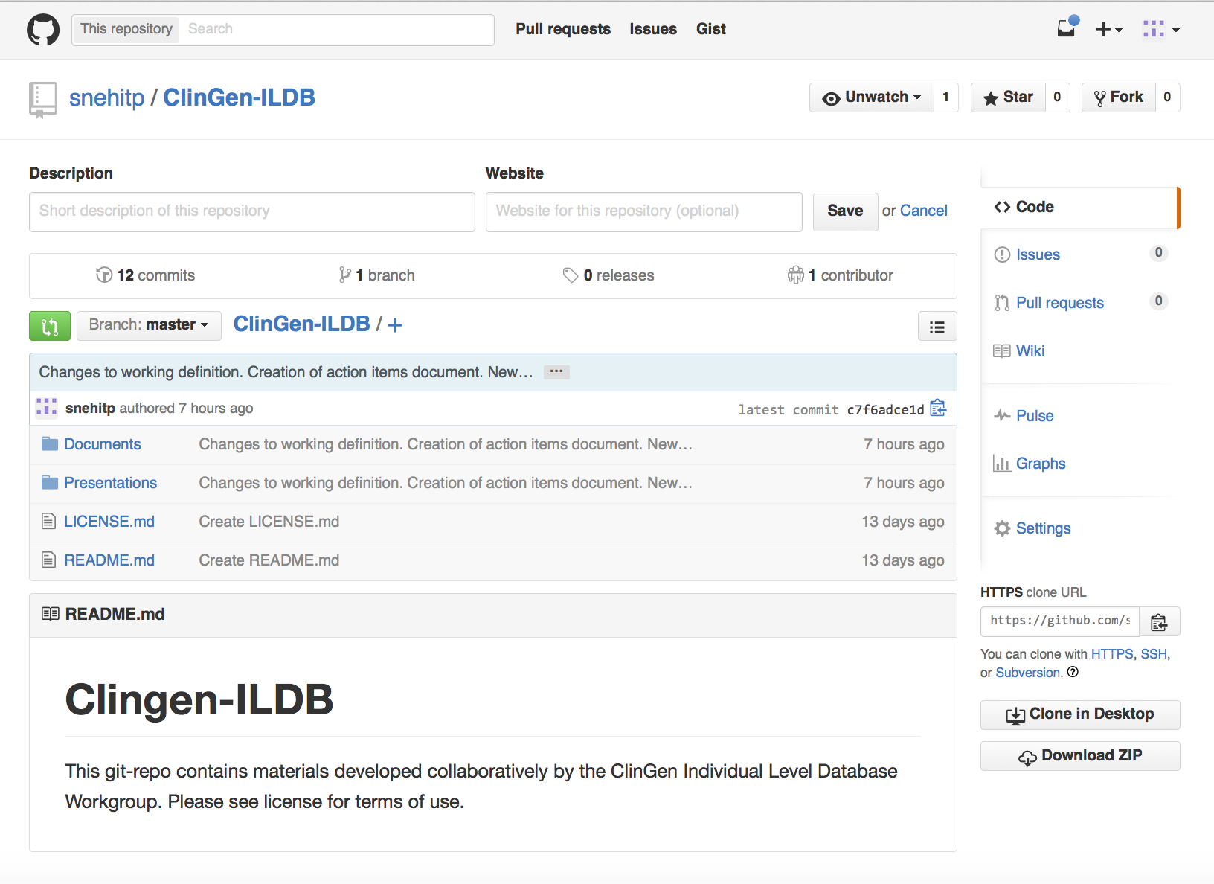
ClinGen ILDB we’re on github …
https://github.com/snehitp/ClinGen-ILDB

Slide 3
ClinGen ILDB A Working Definition
What is the ILDB?
How is it different from existing resources?

Slide 4
ClinGen ILDB A Working Definition
What is the ILDB?
A resource where clinical data (genome + phenome) is deposited
To help ClinGen with curation, interpretation and pathogenicity assessment of genes and variants of clinical significance
How is it different from existing resources?

Slide 5
Resource | Users | Description of use
Gene Matcher (BHCMG) | Connects clinicians and researchers | Help to resolve unsolved/recalcitrant exomes Gene-level query structure
Café Variome (U. Leicester) | Diagnostic testing labs | Discover others who have seen a mutation Help diagnosis through physican contact
DECIPHER (Sanger Inst.) | Wide range: academics, clinicans, researchers | Matching for variant + phenotype carriers. Gene-centric discovery. Help solve cases.
UDN (U. Miami) | Network of hospitals with patient records | Broad matching across many features Mutation centric approach?
Genesis (Via Genetics) | Diagnostic Testing Labs. | This is a software solution for data sharing Users in network generate co-laboratories
RD Connect | ? | Rare disease registry infrastructure Recruitment?
PEER (Genetic Alliance) | Patients who own the data. They decide whether to share | Types of use are dynamic and open ended If you can get consent from patients, you can use the data
BROAD RDAP (Broad Institute) | ? | ?
LOVD (ULeiden, Gen2Phen) | Clinicians (hospitals) looking for interpretations | Gene-centric sequence variant DB. Queries are for solving rare disease cases observed in clinic.
Monarch Initiative (Large consortium) | Researchers | Focus on cross-species queries (orthologous function) Focus on semantics and ontology development
Phenome Central (Care4Rare, NIHUDM) | Clinicians and Researchers | Similarity matching of rare disorder patients with shared phenotype. Discovery of unnamed/undiagnosed disorders also enabled.
Genome Connect (ClinGen) | Connects interested patients to interested researchers | Patient registry model, with access to researchers Queries allow identify participants for research studies
BEACONS (GA4GH) | Exploratory tools for researchers to find datasets with a certain mutation | “Do you have genomes with a given allele at this position?” Variant-centric query structure
Individual Level Database (ClinGen) | ClinGen curators and domain experts | Enable interpretation of genes and variants relevant to a disease Types of Queries?

Slide 6
Variant Interpretation Process Today

Slide 9
Proposed Interpretation Process (ClinGen)

Slide 11
Project timeline
Working Definition
Feasibility Study
Implementation/
Logistics
α/β testing v1 release
Establish utility by
Identifying users
Identify and Address concerns
Collect data and populate
= approx 1 month

Slide 12
Project timeline
Working Definition
Feasibility Study
Implementation/
Logistics
α/β testing v1 release
Establish utility by
Identifying users
Identify and Address concerns
Collect data and populate
= approx 1 month

Slide 13
ClinGen ILDB The road ahead
Several areas where progress needs to be made:
Consent standards
Privacy and security frameworks
Data usage terms, oversight and regulatory issues
Funding sources
Data models and validation
Data submission and QC
Data usage and audit trails
IT infrastructure (security, redundancy, etc.)

Slide 14
ClinGen ILDB Work ahead
Administrative Task Team
Consent standards
Privacy and security frameworks
Data usage terms, oversight and regulatory issues
Funding souces
Implementation Task Team
Data models and validation
Data submission and QC
Data usage and audit trails
IT infrastructure (security, redundancy, etc.)

Slide 15
ClinGen ILDB Work ahead
Administrative Task Team
Consent standards
Privacy and security frameworks
Data usage terms, oversight and regulatory issues
Funding sources
New Membership: Kelly Ormond, Sam Baxter
Notes:
Meet as required

Slide 16
ClinGen ILDB Work ahead
Implementation Task Team
Data models and validation
Data submission and QC
Data usage and audit trails
IT infrastructure (security, redundancy, etc.)
Pilot project to test the waters and the use-cases.
Which features are important for curation?
What kinds of queries?
What constitutes a query “match”?
What user privileges and permissions?
Notes:
More frequent meetings (weekly)

Slide 17
Open for discussion

